Slide 1
March 2025
Notes:
George

Slide 2
Texas Health Services Authority
Created in 2007 by the Texas Legislature as the public/private entity to promote and coordinate electronic health information exchange in the State of Texas.
Operates two major functions: (1) HIETexas -- electronic health information exchange platform, and (2) SECURETexas – a privacy and security certification program.
Governed by a 12-member board of directors, appointed by the Texas Governor and confirmed by the Texas Senate. Two ex-officio members representing state health agencies also sit on the board.
Section 182.101(a)(1), Health and Safety Code
HEALTH AND SAFETY CODE CHAPTER 182. ELECTRONIC EXCHANGE OF HEALTH INFORMATION (texas.gov)

Slide 3
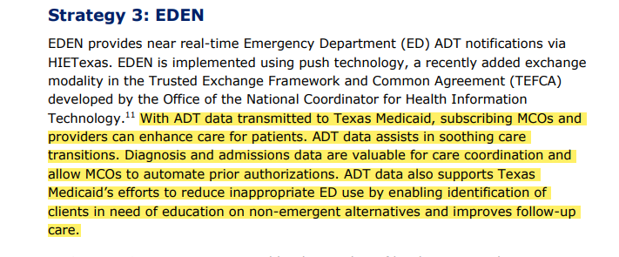
Texas HHSC’s Interoperability for Texas: Powering Health 2022
https://www.hhs.texas.gov/sites/default/files/documents/interoperability-texas-powering-health-dec-2022.pdf

Slide 4
Texas Health Services Authority interoperability lth services authority
Emergency Department Encounter Notifications
Patient Unified Lookup System for Emergencies
Privacy & Security Certification
Real time alerts to determine where a patient has been admitted, discharged or transferred.
Remote and secure access to electronic health information during declared disasters in alternate care sites.
Privacy and security program to certify compliance with state and federal medical privacy and security law.
Supported through a combination of state funds from the Texas Health and Human Services Commission and federal funds from the Centers for Medicare and Medicaid Services.

Slide 5
ED visit Prevented
Sunny Side Home Health received a wound care referral from Dr. Welby for Mr. Smith after a fall he had at home. Nurse Ann has been seeing Mr. Smith and treating the wound.
She notices that Mr. Smith is having trouble ambulating and is dizzy. Nurse Ann looks at the national network and sees that Mr. Smith was discharged from a hospital in another state where his daughter lives two months ago. He had been treated for a heart condition. Nurse Ann checks the medications list against the hospital discharge medication list. They do not match and there are no cardiac medications. Nurse Ann calls Dr. Welby to discuss. Dr. Welby was not advised of the hospital stay in another state nor of the cardiac medications prescribed.
Dr. Welby prescribes blood pressure and cardiac medications.
Notes:
Jennifer

Slide 6
Potentially Preventable Hospital Readmits
Nov 15, 2022
By Jared Kaltwasser
Patient avoidance or postponement of care are common reasons for home health care delays, the authors said.
Patients discharged from the hospital are at a higher risk of re-hospitalization if they experience a delay in post discharge home health care initiation, according to a new study.
The study, published in Journal of the American Medical Directors Association, shows the risk of a re-hospitalization or emergency department (ED) visit jumps by 12% when patients wait more than 2 days for their at-home care to start.
After Hospital Discharge, Slow Home Health Care Initiation Increases Risk of Rehospitalization (ajmc.com) 6.01.2024
Notes:
Katherine

Slide 7
Enhancing Care Coordination
3.27.2023
8 pm
Mrs. Jones fell in her apartment. Her designated caregiver found her and called the ambulance.
The ambulance took her to the local hospital where she was admitted.
Nurse Mary Smith nor the hospitalist are aware that Mrs. Jones has dementia.
The PCP and the MCO care management team receive an encounter notification with local hospital name and attending physician. The PCP immediately calls the hospitalist to advise of Mrs. Jones medical history. The MCO care management team call to initiate discharge planning process with hospital.
3.28.2023
8 am
Notes:
Mindy

Slide 8
Paths to Connect to HIETexas EDEN
Option: Directly share ADT data to EDEN
Health and Human Services Commission
HIETexas EDEN
(THSA)
Managed Care Organizations
TX Regional HIE
Option: Directly share ADT data to a regional HIE that shares it with EDEN

Slide 9
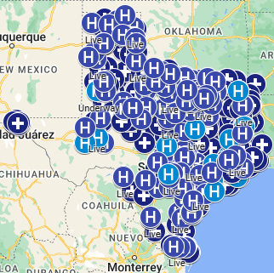
THSA Network Participation (for exchange of ADT data)
 | Live | Underway
Acute Hospitals | 169 | 43
Post Acute Hospitals | 659 | 17
Behavioral Health Hospitals | 7 | 18
Urgent Care | 7
Total Organizations | 913
598 Total Texas Hospitals with 38% THSA Participants
Texas Health Data - Texas Hospital Data

Slide 10
Potentially Preventable Readmits (PPR)
Star provides benefits for low-income children, pregnant woman and families analysis showed PPR rates lower than target for 65.2% of HIETexas participating hospitals as compared to 49.4% of all others associated with a net positive monetary impact of $522,665.
Star + Plus provides benefits for adults who have disabilities or are age 65 and older showed a similar pattern with 63.1% of participating hospitals lower than target as compared to 53.3% of others associated with a net positive monetary impact of $708,710.
Star Health provides benefits for foster children and youth under the age of twenty who are former foster care children showed a smaller impact with one hospital with a rate lower than the State average associated with a net positive monetary impact of $13,316.47.
Star Kids provides benefits for children and young adults with disabilities. There were 3 HIETexas participating hospitals lower than target and four higher. There was a net negative monetary impact on this group of ($240, 247).
PPR Financial Savings for Medicaid: $1,004,444 = $522,665 + $708,710 + $13,316 + ($240,247)
Notes:
Analysis of data provided by the Texas Healthcare Learning Collaborative (THLC) showed that participation in HIETexas EDEN improved care coordination and decreased cost for the Medicaid population in 2023.

Slide 11
Potentially Preventable Emergency Department Visits (PPV)
Star provides benefits for low-income children, pregnant woman and families analysis showed PPV rates lower than target for 74% of HIETexas participating hospitals as compared to 50.8% of all others associated with a net positive monetary impact of $2,868,620.
Star + Plus provides benefits for adults who have disabilities or are age 65 and older showed a similar pattern with 77.1% of participating hospitals lower than target as compared to 53.3% of others with a net positive monetary impact of $1,038,050.
Star Health provides benefits for foster children and youth under the age of twenty showed a similar pattern with 62.1% of participating hospitals lower than target as compared to 41% of others with a net positive monetary impact of $52,929.
Star Kids provides benefits for children and young adults with disabilities. The trend continued in this population with 67.6% of participating hospitals lower than the target as compared to 43.5% of others with a net positive monetary impact of $311,434.
PPV Financial Savings for Medicaid: $4,271,033 = $2,868,620 + $1,038,050 + $52,929 + $311, 434

Slide 12
Powered Care coordination
MCOs
Community Physicians
Care Management:
Renal
Diabetes
Chronic Disease
Cardiac
Sickle Cell
Home Care
Palliative Care
DME
Remote Monitoring
Home Care
Hospitals
Post-Acute Care
Telehealth

Slide 13
contact Information
Phil.Beckett@THSA.org

